Slide 1
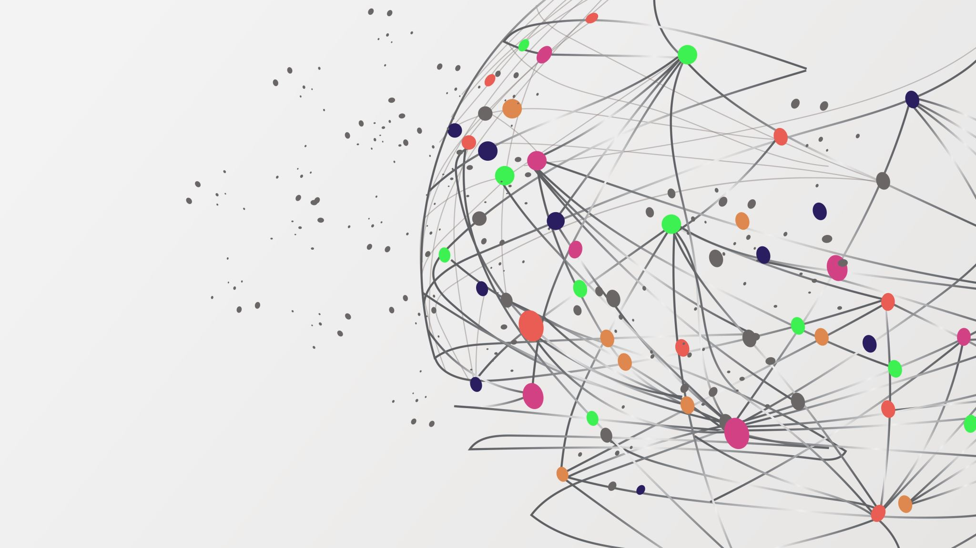
Service-Oriented Architecture
Answering What and Why

Slide 2

Module 1 - Introduction to SOA

Slide 3

Course Objective
Understand software architecture fundamentals
Define what services are
Describe Service-Oriented Architecture (SOA)
Identify the core components of SOA
Analyze the benefits and challenges of SOA
Compare SOA with other architectural styles
Apply SOA concepts

Slide 4
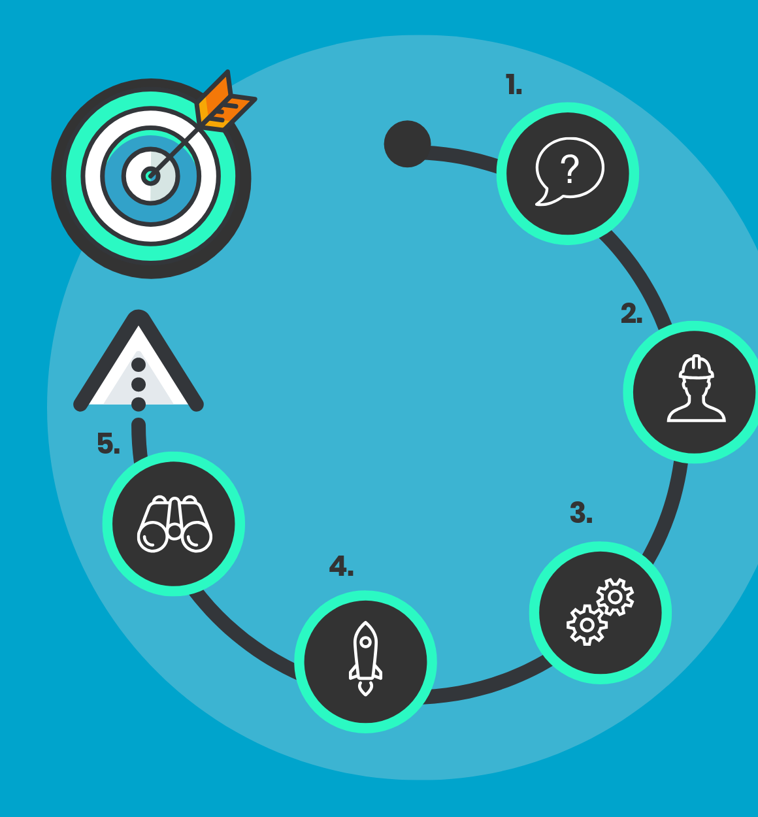
Course Approach
Real-World Example from Day One: We will select a practical case scenario to anchor our learning.
Collaborative Learning: Students will work in groups of 3 to encourage teamwork and idea sharing.
Service Identification: Each group will break down the scenario and identify potential services.
Progressive Design: Week by week, we will refine and extend the architecture, applying concepts as we learn them.
Final Product Architecture: By the end of the course, each group will deliver a complete SOA-based architecture for their chosen scenario.

Slide 5

Let’s start from defining SW-Architecture
👉 “Software architecture defines the fundamental organization of a system its components, their relationships, and the principles guiding its design and evolution.”
High-level blueprint of a software system.
Describes the structure of components, how they interact, and the guiding principles and decisions.
Often compared to the blueprints of a building: it doesn’t describe every detail, but it sets constraints and direction.

Slide 6

Why We Need Software Architecture
Clarity & Direction: Provides a shared understanding among developers, managers, and stakeholders.
Quality Attributes: Enables achieving non-functional requirements like scalability, reliability, maintainability, and performance.
Decision Making: Serves as a framework for making trade-offs (e.g., flexibility vs. efficiency).
Risk Management: Surfaces critical design risks early, before costly development.
Evolution: Makes systems easier to extend and integrate with new technologies.

Slide 7
Lead-In to SOA
Traditional architectures often focused on monolithic or tightly coupled systems.
As systems grew more complex and distributed, a new approach was needed.
SOA emerged to address flexibility, integration, and reusability of services across systems.

Slide 8

What is a Service?
A self-contained unit of functionality that performs a specific business task (e.g., “process payment,” “check inventory”).
Well-defined and reusable, designed to be used in different contexts.
Accessible via an interface (usually an API), hiding internal details from the user.
Independent loosely coupled so it can evolve without breaking the whole system.

Slide 9

Key Characteristics of Services
Encapsulation፡ Internal logic is hidden; only the contract (interface) is exposed.
Reusability፡ Can be consumed by multiple applications.
Interoperability፡ Can communicate across platforms/technologies via standard protocols.
Discoverability፡ Can be published, located, and invoked easily in a larger system.

Slide 10
What is Service-Oriented Architecture (SOA)?
SOA is a style of software architecture where systems are designed as a collection of independent, reusable services.
Each service represents a business function (e.g., “Customer Management,” “Billing,” “Inventory Check”).
Services communicate through well-defined interfaces (often via standard protocols like HTTP, SOAP, or REST).
The goal: enable flexibility, reusability, and integration across different applications and technologies.
Functional City
transport service
utility service
financial service
Delivery
Order reception
Dispatcher
Driver
Restaurant
Waiter
Chef
Operations

Slide 11

Key Principles of SOA
Loose Coupling → Services are independent, reducing dependencies.
Reusability → Services can be reused across multiple applications.
Interoperability → Services work across different platforms, languages, or vendors.
Composability → Services can be combined to form larger business processes.

Slide 12

Why SOA? (The Problem It Solves)
Pain points of traditional (monolithic, siloed) systems.
Challenges: tight coupling, difficulty integrating, duplication of functionality.
How SOA addresses these challenges (flexibility, reusability, integration).

Slide 13
Benefits and Challenges of SOA
Category | Benefits | Challenges
Technical | Reusability, Interoperability, Scalability | Complexity, Performance, Testing
Business | Agility, Alignment, Cost Efficiency | High Initial Investment, Change Management
Organizational | Integration, Process Flexibility | Governance, Cultural Resistance

Slide 14

We know WHAT is SOA

Slide 15

We know WHY we need SOA

Slide 16
Module 2 - Modern SDLC

Slide 17
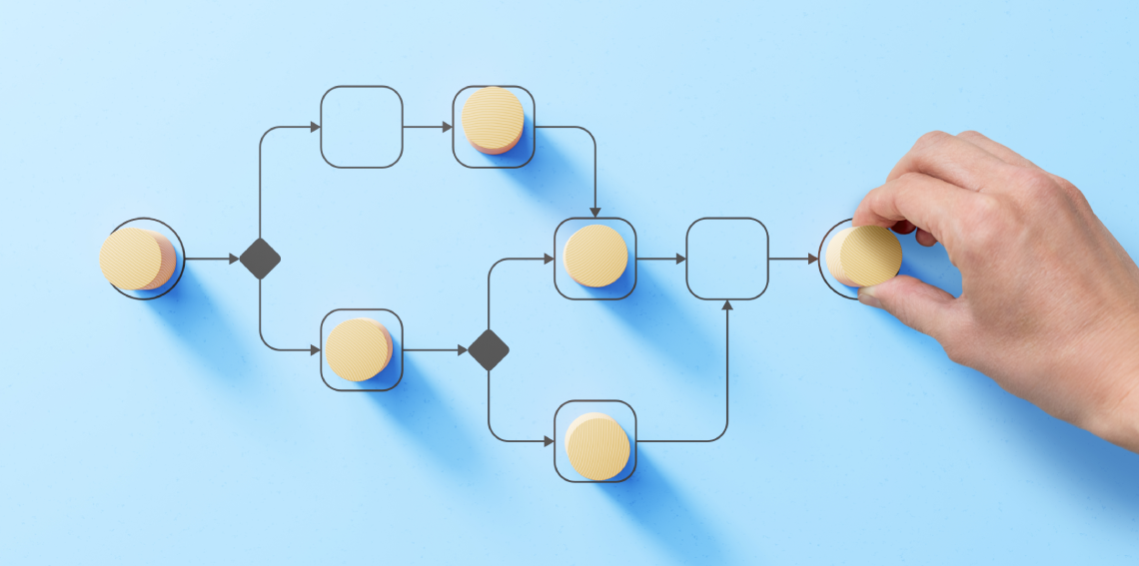
Concepts to understand
Agile
CI/CD (Continuous Integration / Continuous Delivery)
Containerization
Orchestration

Slide 18

Agile
Focuses on iterative delivery and continuous feedback to adapt quickly to change.
Encourages cross-functional collaboration between development, QA, and business teams.
Emphasizes working software over documentation, enabling faster value delivery.
Uses frameworks like Scrum or Kanban for structured yet flexible progress.

Slide 19
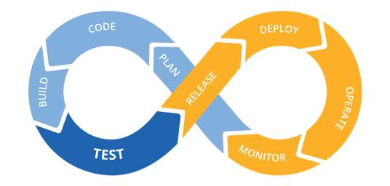
CI/CD (Continuous Integration / Continuous Delivery)
Automates build, test, and deployment processes to ensure rapid, reliable releases.
Detects integration issues early through frequent code merges and automated tests.
Enables faster feedback loops and reduces human error in deployments.
CI/CD pipelines are the backbone of DevOps culture and modern delivery speed.

Slide 20

Containerization
Packages applications with all dependencies for consistent behavior across environments.
Simplifies deployment, scaling, and rollback of applications.
Common tools: Docker, Podman.
Increases portability from developer laptop to production server.

Slide 22
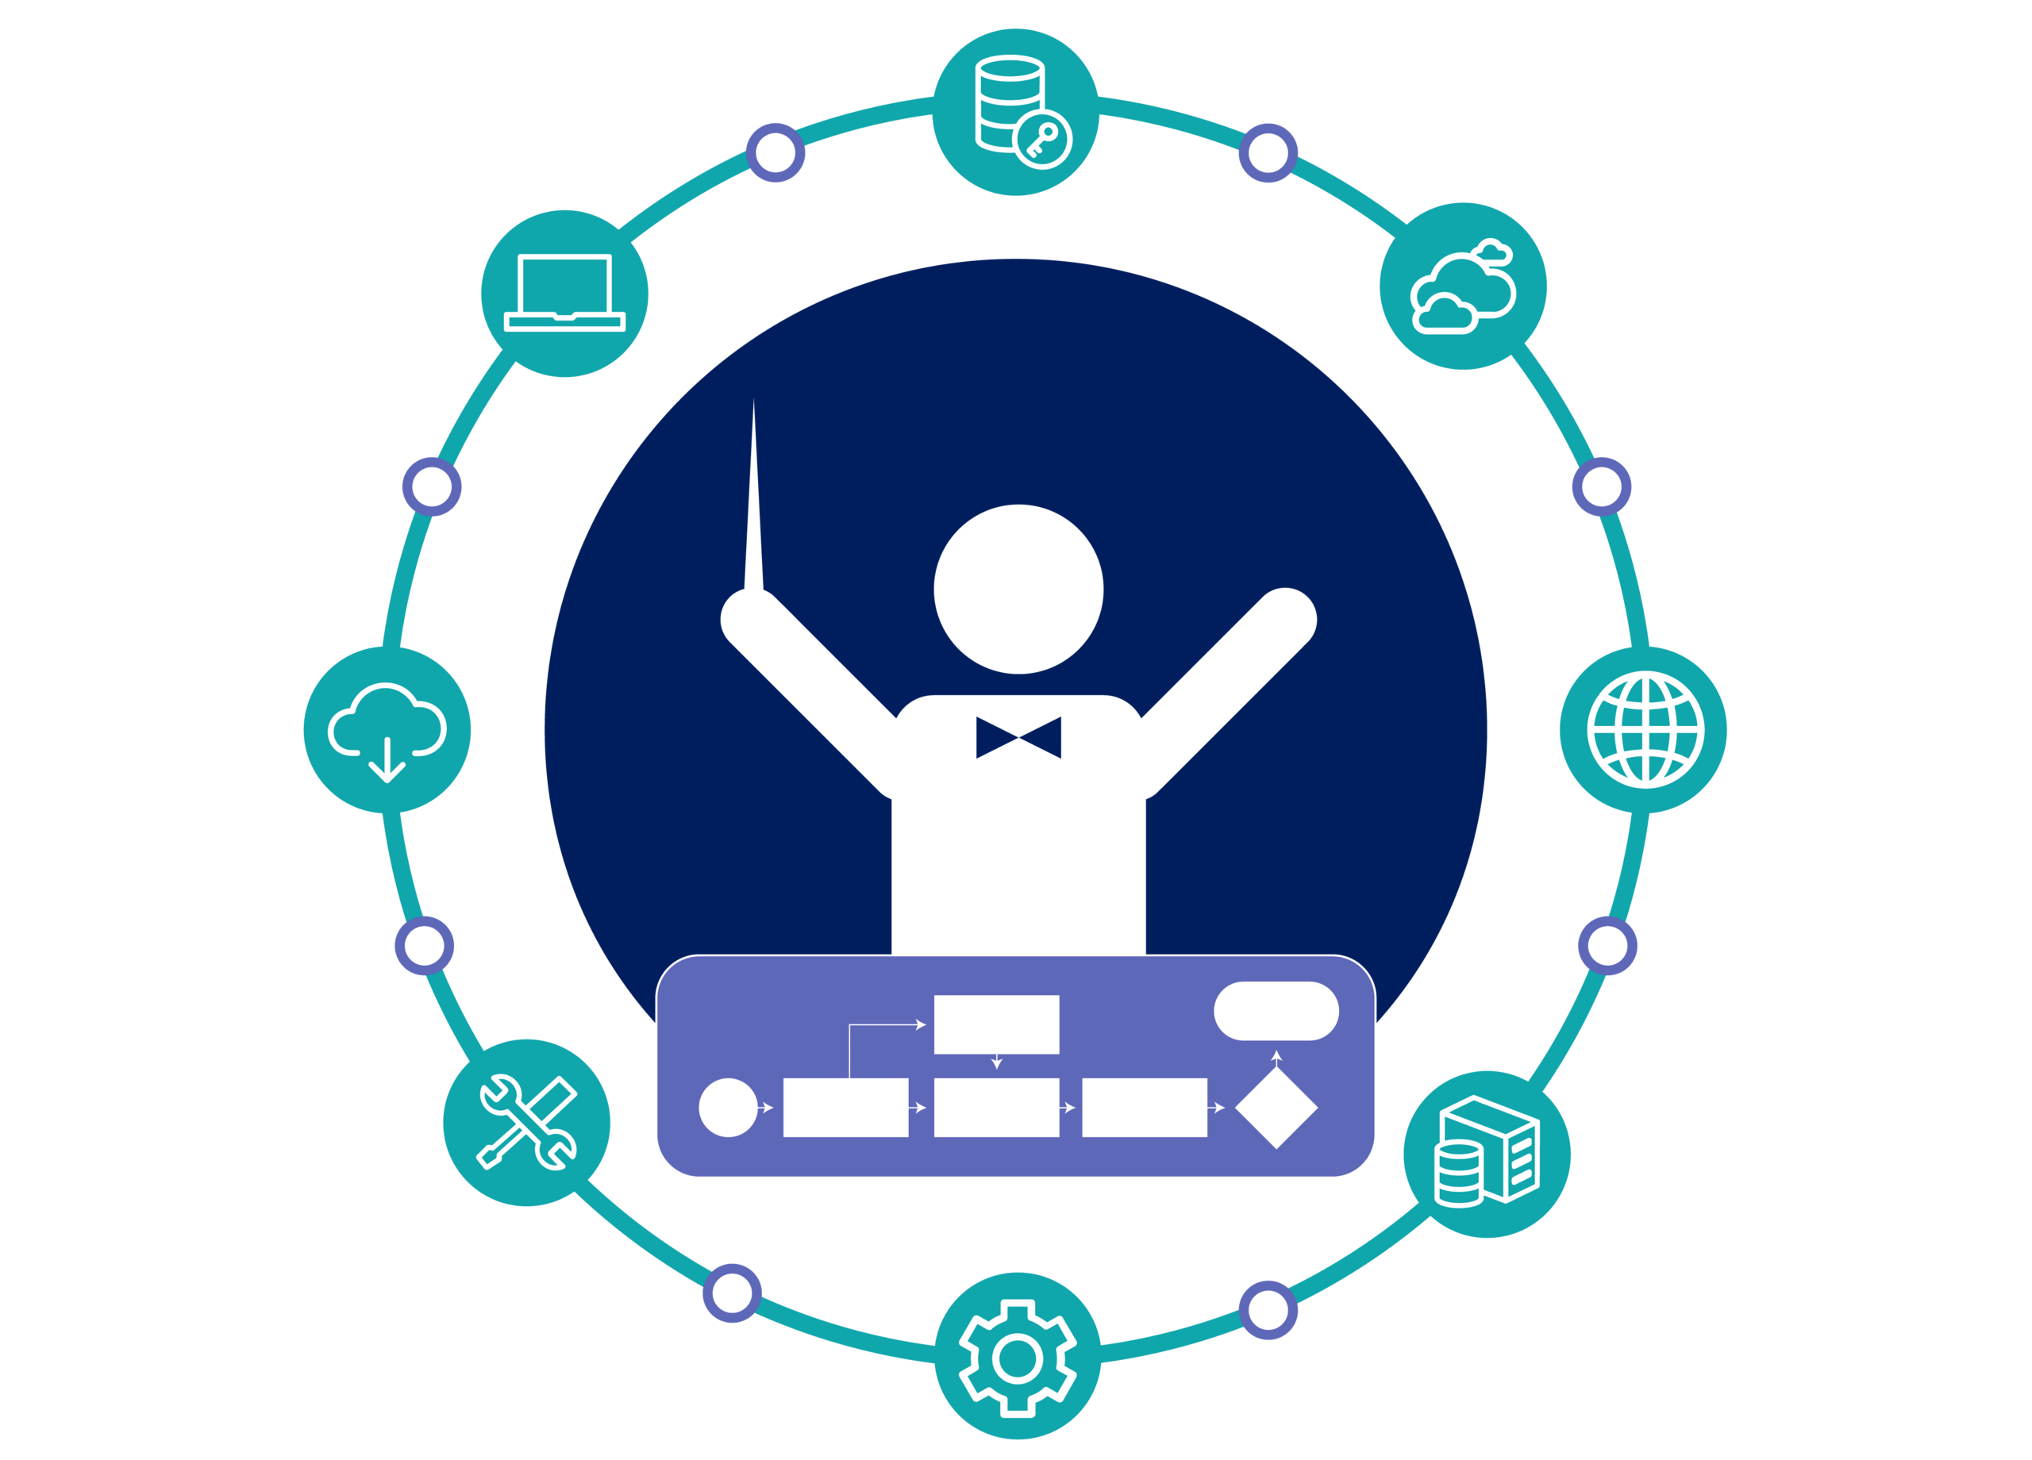
Orchestration
Automates the management, scaling, and coordination of containers across clusters.
Ensures high availability, load balancing, and self-healing systems.
Key platforms: Kubernetes, Docker Swarm, OpenShift.
Integral to managing microservices architectures at scale.

Slide 23
Module 3 - SOA Layers

Slide 24
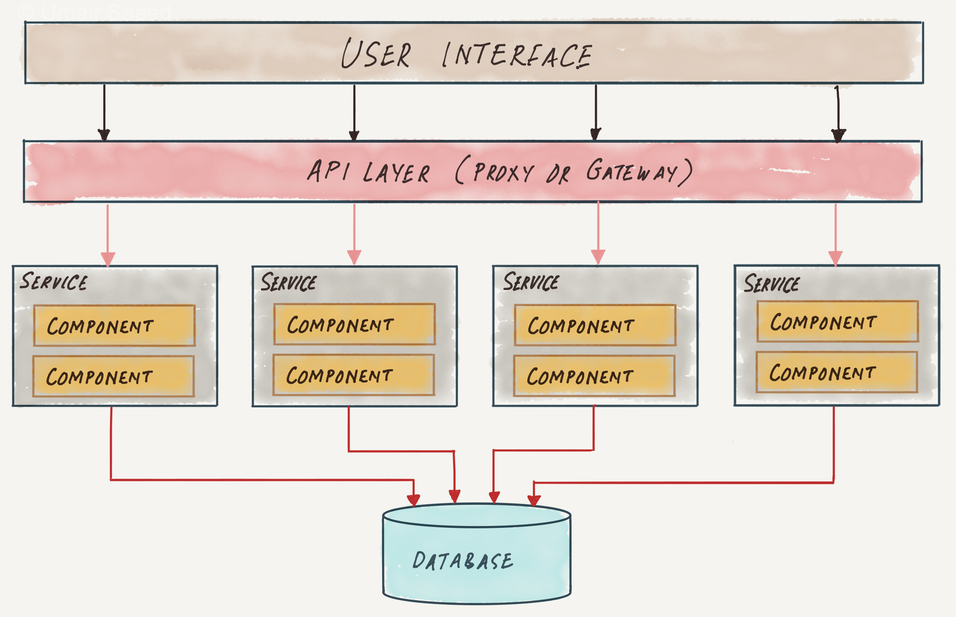
SOA Layers - Operational Systems Layer
What it is:
This is the foundation layer of SOA that contains the existing enterprise systems and data sources.
Examples:
Legacy applications, ERP systems (like SAP), CRM systems, and databases.
Role:
It provides the core business functionality and data that higher layers expose as services.
Key idea:
SOA does not replace these systems — it wraps them so their functionality can be reused.

Slide 25
SOA Layers - Service Component Layer
What it is:
This layer contains software components that encapsulate and expose specific functionality from the operational systems as services.
Examples:
A “Customer Management Component” that retrieves customer data from a CRM system and exposes it as a web service.
Role:
Acts as a bridge, isolating service logic from the complexities of underlying systems.
Key idea:
Promotes modularity and reusability, each component can be developed, deployed, and maintained independently.

Slide 26
SOA Layers - Services Layer
What it is:
This layer contains the actual services that can be discovered and invoked by other parts of the architecture.
Examples:
Services like “GetCustomerDetails”, “PlaceOrder”, “CheckInventory”.
Role:
Provides a catalog of well-defined business and application services that can be reused by multiple applications.
Key idea:
Defines standardized, interoperable interfaces (often using APIs or web services).

Slide 27
SOA Layers - Business Process Layer
What it is:
This layer focuses on business workflows and process orchestration how individual services are combined to achieve business goals.
Examples:
A “FulfillOrder” process that orchestrates “CheckInventory”, “ProcessPayment”, and “ShipOrder” services.
Role:
Coordinates multiple services to implement complex business processes.
Key idea:
Enables flexibility — processes can be modified or automated without changing the underlying systems.

Slide 28
SOA Layers – Consumer Layer
What it is:
The top layer where end-users, applications, or external systems access the services and processes.
Examples:
Web portals, mobile apps, dashboards, or partner systems consuming APIs.
Role:
Provides interfaces for interaction with the SOA environment.
Key idea:
Ensures usability, presents aggregated and meaningful information to users or other systems.

Slide 29
Module 4 - SOA Infrastructure

Slide 30
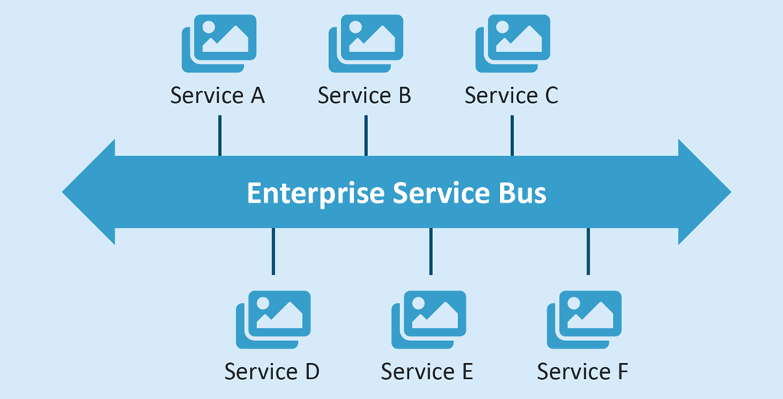
SOA Infrastructure – ESB
Definition: An Enterprise Service Bus is a middleware that enables different services and applications to communicate with each other in a standardized, loosely coupled way.
Why it matters: ESB removes point-to-point integrations and replaces them with a central communication hub, simplifying service interaction and reducing integration complexity.
Example: If a CRM service sends customer data in XML but the inventory service only understands JSON, the ESB automatically transforms and routes the message appropriately.

Slide 31
SOA Infrastructure – ESB
Main functions:
Message routing: Directs messages between services (e.g., from Order Service to Payment Service).
Message transformation: Converts data formats or protocols (e.g., XML → JSON).
Protocol mediation: Allows communication between services using different technologies (e.g., HTTP, JMS, FTP).
Security and monitoring: Provides authentication, authorization, and message tracking.

Slide 32
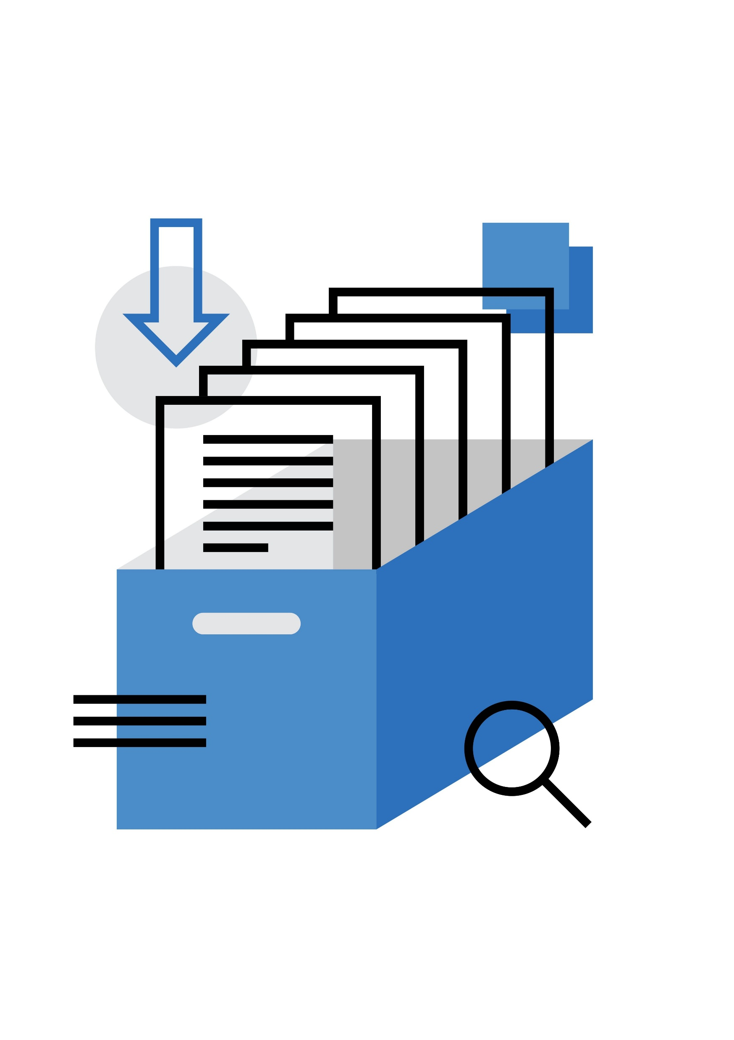
SOA Infrastructure – Service Registry / Repository
Definition: A Service Registry (and its companion Repository) is like a “yellow pages” or directory for all services in the SOA environment.
Why it matters:
It ensures that all services are discoverable, reusable, and managed consistently across the enterprise.
Example: When a new application needs customer information, it searches the registry for “CustomerDataService” instead of creating a new one — promoting reuse.

Slide 33
SOA Infrastructure – Service Registry / Repository
Main functions:
Service discovery: Allows developers and applications to find available services by name, type, or interface.
Metadata management: Stores details like service descriptions (WSDLs, endpoints, policies, and versions).
Governance and lifecycle management: Helps control service versions, ownership, and usage policies.

Slide 34

SOA Infrastructure – Message Brokers
Definition: A Message Broker is a middleware system that handles message queuing, routing, and event distribution between services — often part of or working alongside the ESB.
Why it matters:
Improves scalability and reliability — enabling services to communicate efficiently even under high loads or network interruptions.
Example:
When an order is placed, an “OrderPlaced” message is published to the broker. Inventory, billing, and notification services each subscribe and react independently.

Slide 35
SOA Infrastructure – Service Message Brokers
Main functions:
Asynchronous communication: Allows services to send and receive messages without waiting (decoupling producers and consumers).
Reliable delivery: Ensures messages are not lost even if a service is temporarily unavailable.
Event-driven integration: Supports publish/subscribe and event-based architectures.

Slide 36
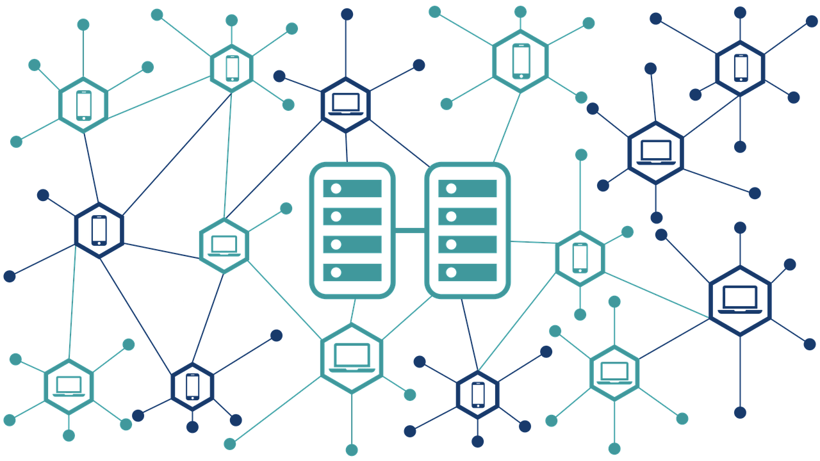
Distributed systems
A collection of independent computers that appear to users as a single coherent system.
Designed for scalability, fault tolerance, and high availability.
Enable parallel processing and resource sharing across multiple nodes.
Require mechanisms for data consistency, synchronization, and communication.
Common challenges: latency, network failures, concurrency, and security.

Slide 37
Module 5 - Service Communication & Protocols
How Services Talk to Each Other??

Slide 38
Learning Objectives
Understand three major service communication protocols: REST, SOAP, and gRPC
Compare their strengths, weaknesses, and use cases
Explore message format options and their trade-offs
Learn API versioning strategies and backward compatibility
Apply these concepts to your group project architecture

Slide 39
The Challenge: How Do Services Communicate?
In a Service-Oriented Architecture, services must:
Exchange data reliably and efficiently
Work across different programming languages and platforms
Handle varying performance requirements
Maintain backward compatibility as they evolve

Slide 40
REST: Representational State Transfer
Definition : Client-server architecture based on HTTP methods and resource-oriented design
Core Principle: Resources accessed via URLs, manipulated using HTTP verbs (GET, POST, PUT, DELETE)

Slide 41
REST: Key Characteristics
Stateless: Each request contains all info needed; server maintains no client context
Cacheable: Built-in HTTP caching support improves performance
Loosely Coupled: Clients and servers can evolve independently
Resource-Oriented: Everything is a resource with a unique identifier (URL)

Slide 42
REST: Practical Example
Customer Service Endpoints:
GET /api/v1/customers/123
GET /api/v1/customers
POST /api/v1/customers
PUT /api/v1/customers/123
DELETE /api/v1/customers/123
Response: JSON or XML with customer data

Slide 43
REST: Advantages & Challenges
Advantages
Simple and intuitive
Excellent for public APIs
Built-in caching
Browser-friendly
Challenges
Chatty (many requests)
Over/Under-fetching issues
Not ideal for streaming
Limited for real-time

Slide 44
SOAP: Simple Object Access Protocol
Definition: XML-based protocol with strict standards and built-in security for enterprise integration
Structure : Envelope → Header (metadata) + Body (message) + Fault (errors)

Slide 45
SOAP: Key Characteristics
XML-Only: All messages are XML, both request and response
Formal Contract: WSDL (Web Service Definition Language) defines the service contract
Security & Compliance: WS-Security, ACID transactions for enterprise use
Built-in Error Handling: SOAP Faults provide detailed error information

Slide 46
ACID – Let’s define it in our way
🔐 ACID Properties in Databases
1️⃣ A — Atomicity
“All or nothing.” A transaction must be treated as a single unit. Either every step succeeds, or none of them is applied.
Example: Transferring money from Account A to Account B involves
deducting from A
adding to B
If one fails, the whole transaction is rolled back.

Slide 47
ACID – Let’s define it in our way
2️⃣ C — Consistency
“Data must remain valid and follow the rules.” After a transaction completes, the database must follow all defined rules, constraints, and relationships.
Example:
A column marked UNIQUE cannot have duplicates
Foreign keys must match existing records
Total balances cannot become negative if rules prohibit it

Slide 48
ACID – Let’s define it in our way
3️⃣ I — Isolation
“Transactions should not interfere with each other.” Even when many users access the database at the same time, each transaction acts as if it’s the only one running.
Isolation prevents problems like:
Dirty reads
Non-repeatable reads
Different isolation levels (READ COMMITTED, SERIALIZABLE, etc.) give different guarantees.

Slide 49
ACID – Let’s define it in our way
4️⃣ D — Durability
“Once committed, data is permanent.” After a transaction is committed, the changes will not be lost, even if:
Power fails
System crashes
Database restarts
Databases ensure this using logs, checkpoints, and backups.

Slide 50
ACID – Let’s define it in our way
4️⃣ D — Durability
“Once committed, data is permanent.” After a transaction is committed, the changes will not be lost, even if:
Power fails
System crashes
Database restarts
Databases ensure this using logs, checkpoints, and backups.

Slide 51
SOAP: Message Structure
<soap:Envelope>
<soap:Header>
<auth:Credentials>...</auth:Credentials>
</soap:Header>
<soap:Body>
<GetCustomer>
<CustomerID>123</CustomerID>
</GetCustomer>
</soap:Body>
</soap:Envelope>

Slide 52
SOAP: Advantages & Challenges
Advantages
Enterprise-grade security
ACID compliance
Formal contracts (WSDL)
Better error handling
Challenges
Complex and verbose
Heavy XML processing
Steep learning curve
Slower performance

Slide 53
API Versioning: The Reality
Problem: Services evolve, APIs change, clients depend on them
New features require API modifications
Old clients still need to work (backward compatibility)
Removing old features can break dependent systems
Multiple versions must coexist temporarily

Slide 54
API Versioning: Common Strategies
URL Path – Clear, Visible
/api/v1/customers
Header - Abstracted
Accept: application/
vnd.api.v1+json
Query Param - Flexible
/api/customers?
version=1.0

Slide 55
Backward Compatibility Best Practices
Additive Changes Only: Add new fields/endpoints, don't remove or rename old ones
01
Deprecation Warnings: Use HTTP headers to warn about upcoming changes (X-API-Deprecation)
02
Semantic Versioning: Follow MAJOR.MINOR.PATCH (v2.1.3) to signal breaking changes
03
Testing: Maintain automated tests against all active API versions
04

Slide 56

REST = Simple, web-friendly, loosely coupled
SOAP = Enterprise-grade, secure, formal contracts
Versioning = Plan for backward compatibility from day one
No one-size-fits-all = Choose based on your requirements

Slide 57
Module 6 - Design Pattern
How Services Talk to Each Other??

Slide 58
Learning Objectives
Master
Master three critical service design patterns: Saga, Circuit Breaker, API Gateway
Understand
Understand synchronous vs asynchronous communication patterns
Compare
Compare Request-Reply vs Publish-Subscribe messaging
Learn
Learn data consistency patterns for distributed systems
Apply
Apply patterns to your group project architecture

Slide 59

Why Design Patterns Matter
In distributed systems, patterns solve recurring problems:
Reliability: Prevent cascading failures and service outages
Consistency: Ensure data stays synchronized across services
Scalability: Handle growing load without breaking
Maintainability: Standardized solutions everyone understands

Slide 60
Service Design Patterns: Three Pillars
Saga Pattern: Managing distributed transactions
Circuit Breaker: Preventing cascading failures
API Gateway: Unified service entry point

Slide 61

The Problem: Distributed Transactions
Traditional ACID transactions don't work across multiple services:
Order Service → Inventory Service → ❌ Payment Service → Shipping Service
If Payment Service fails, how do we rollback the order and inventory deduction?

Slide 62
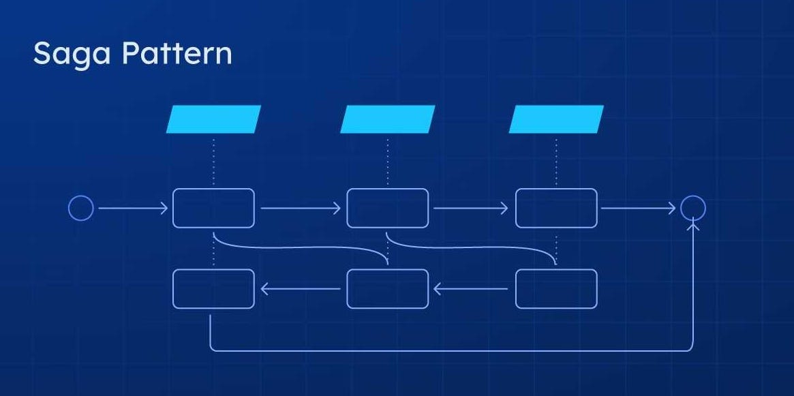
Saga Pattern: Distributed Transaction Management
Definition: A sequence of local transactions coordinated across services, with compensating transactions for rollback.
Each service performs its local transaction and publishes an event
Next service listens to event and executes its transaction
If any service fails, compensating transactions execute in reverse order
Achieves data consistency without distributed locks

Slide 63
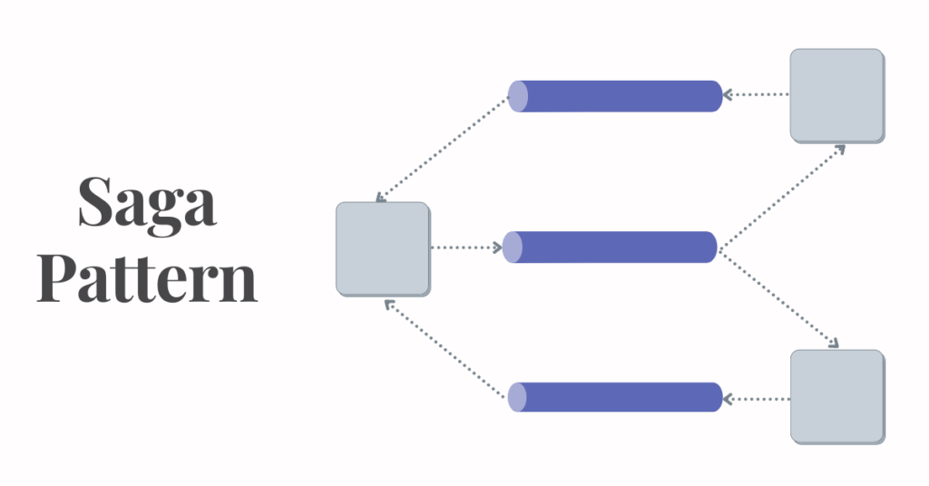
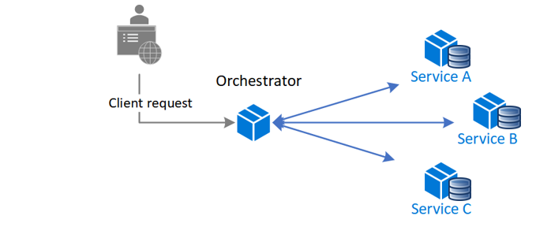
Saga Pattern: Choreography vs Orchestration
Choreography: Services exchange events directly, no central coordinator
✓ Loosely coupled, no single point of failure
✗ Complex logic, hard to track flow
Orchestration: Central coordinator controls the transaction flow
✓ Clear flow, easy to understand
✗ Tightly coupled to coordinator

Slide 64
Saga Pattern: Order Processing Flow
1. Order Service: CreateOrder(Order) → Order Created
2. Inventory Service: ReserveInventory(Item) → Inventory Reserved
3. Payment Service: ProcessPayment(Amount) → FAILS ❌
Compensate:
3. Payment Service: CancelPayment(Amount) ✓
2. Inventory Service: ReleaseInventory(Item) ✓
1. Order Service: CancelOrder(Order) ✓

Slide 65
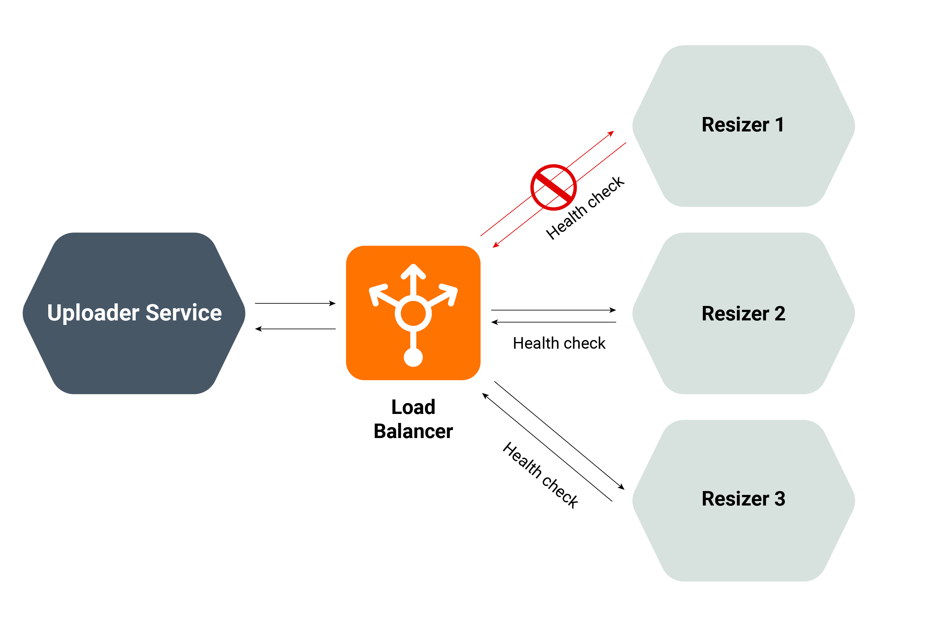
Circuit Breaker Pattern: Preventing Cascades
Definition: Monitoring service health; prevents repeated calls to failing services
Stops cascading failures: If Service B is down, don't let Service A keep trying
Gives failed service time to recover
Returns fast errors rather than timeouts
Automatic recovery when service health returns
Usually implemented through load balancers.

Slide 66
Circuit Breaker: State Transitions
CLOSED:
Normal operation
Requests pass through
OPEN
Failures exceeded
Fail fast, no requests
HALF-OPEN
Testing recovery
Limited requests allowed

Slide 67
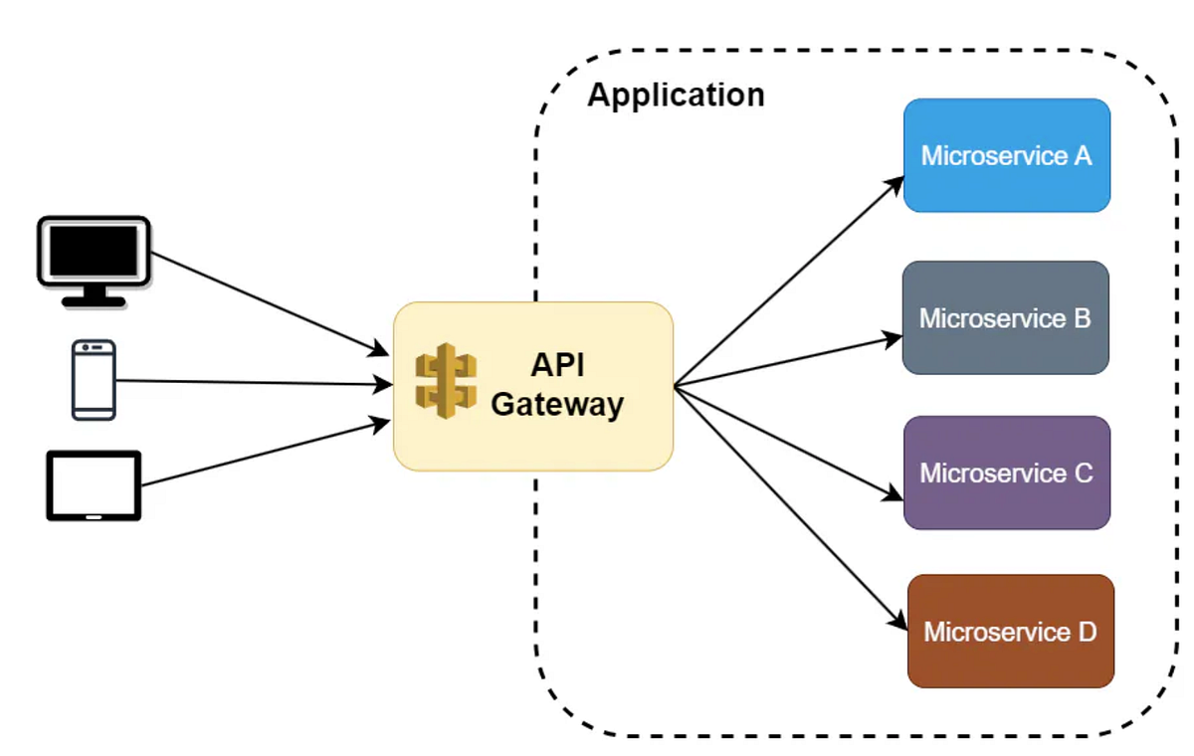
API Gateway Pattern: Single Entry Point
Definition: Unified facade that routes client requests to appropriate microservices
A unified facade is a design pattern that provides a single, simplified interface to a complex subsystem or multiple services. It acts as a wrapper that hides the complexity of underlying components and exposes only what clients need.
Routing: Direct requests to correct services
Aggregation: Combine data from multiple services for single response
Cross-cutting: Authentication, rate limiting, caching, logging
Protocol translation: Convert between REST, gRPC, SOAP formats

Slide 68
Communication Patterns: Two Fundamental Approaches
Synchronous: Request waits for response
Immediate feedback
✓ Best For
Web APIs (REST, gRPC)
Real-time queries
User-facing operations
Immediate response needed
⚠ Challenges
Tight coupling
Cascading failures risk
Slower overall latency
Scaling limitations
Asynchronous: Fire-and-forget via messaging
✓ Best For
Background processing
Notifications & alerts
Batch operations
Long-running tasks
✓ Benefits
Loose coupling
Better scalability
Resilience to failures
Handles traffic spikes

Slide 69
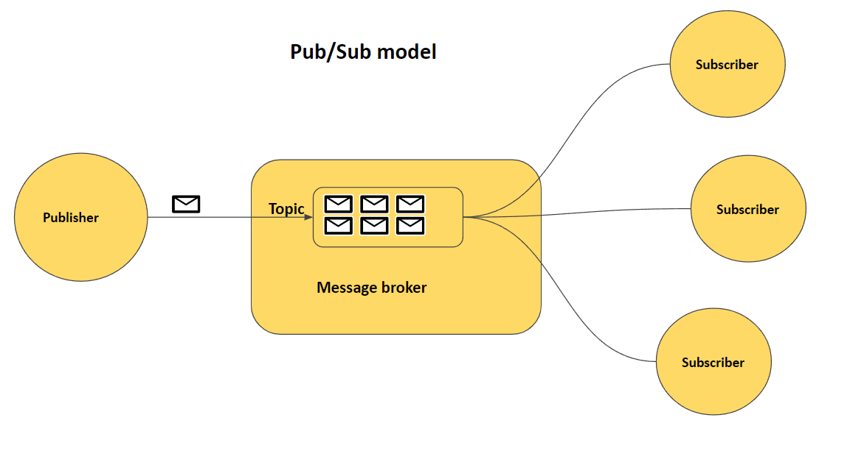
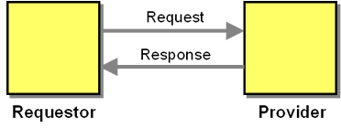
Messaging Patterns: Request-Reply vs Pub-Sub
Request-Reply
Pattern: Sender awaits response
Use: "Get customer details"
Timing: Point-to-point, 1:1
Publish-Subscribe
Pattern: Publisher emits, subscribers receive
Use: "Order created" event
Timing: Topic-based, 1:Many

Slide 70
Pub-Sub: Real-World Example
User places order
Order Service → Publishes "OrderCreated" event
Message Broker receives and distributes:
✓ Inventory Service → Reserves stock
✓ Notification Service → Sends confirmation email
✓ Analytics Service → Records order metrics
Result: All services react independently, loosely coupled

Slide 71
Choosing the Right Pattern
Use
Saga
Coordinating steps across services, need rollback capability
Use
Circuit Breaker
Calling potentially failing services, preventing cascades
Use
API Gateway
Multiple clients need consistent interface to many services
Use
Async Messaging
Services can work independently, loose coupling needed

Slide 72
Common Mistakes to Avoid
Using Saga for simple operations (overengineering)
Not implementing Circuit Breaker for critical dependencies
Making API Gateway a bottleneck with too much logic
Choosing async everywhere (can add complexity)
Ignoring compensating transaction failures in Saga

Slide 73
Module 7 - Microservice
How Services Talk to Each Other??

Slide 74
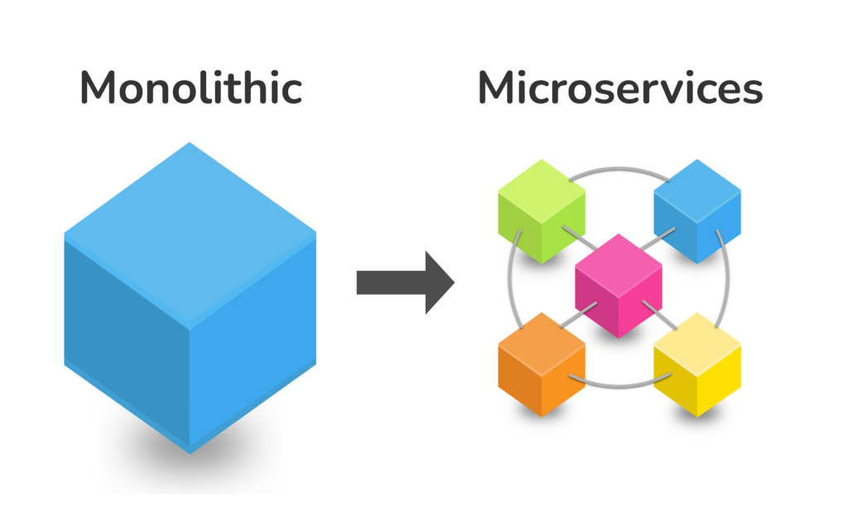
Learning Objectives
Understand microservices as an evolution of SOA principles
Compare monolithic, SOA, and microservices architectures
Learn service decomposition using Domain-Driven Design
Master modern deployment with Docker and Kubernetes
Apply microservices to your group project

Slide 75
The Evolution: From Monolith to Microservices
Timeline of architectural thinking:
2000s: Monolithic architecture (everything in one application)
2005+: Service-Oriented Architecture (SOA) emerges for enterprise integration
2010s: Microservices gains momentum with containerization and cloud
2020+: Cloud-native microservices become standard practice

Slide 76

What Are Microservices?
Definition: An architecture where a single application is composed of many loosely coupled, independently deployable small services, each running in its own process and communicating via well-defined APIs.
Each service has a single business capability
Services are independently scalable and deployable
Teams own their services end-to-end
Modern DevOps and cloud-native practices

Slide 77
SOA vs Microservice
SOA
Coarse-grained services
Shared data stores
ESB middleware required
Enterprise integration focus
Standardized platforms
Microservice
Fine-grained services
Database-per-service
Direct APIs (REST, gRPC)
Business capability focus
Polyglot technology stack

Slide 78
Why Adopt Microservices?
✓ Benefits
Fine-grained services
Database-per-service
Direct APIs (REST, gRPC)
Business capability focus
Polyglot technology stack
⚠ Challenges
Operational complexity
Network latency
Data consistency
Distributed debugging
Requires DevOps culture

Slide 79
Core Microservices Principles
Service Autonomy
Each service operates independently, owns its data, makes its own decisions
Business Alignment
Services map to business capabilities, not technical layers
Resilience by Design
System survives individual service failures
Observable
All services instrumented for monitoring and debugging

Slide 80

Domain-Driven Design: Decomposition Strategy
Key Concept: Bounded Contexts
Each bounded context becomes one microservice
E-commerce Domain Example:
Catalog Context: Products, inventory, search
Order Context: Orders, order fulfillment
Payment Context: Transactions, billing
Shipping Context: Logistics, delivery tracking

Slide 81
How to Decompose a Monolith
Understand the Domain: Map business capabilities and data flows
Identify Boundaries: Use DDD to find natural service boundaries
Define APIs: What data does each service expose and consume?
Plan Data Strategy: Decide on database-per-service approach
Implement Communication: Choose sync (REST/gRPC) or async (events)
Deploy Independently: Each service deployed separately

Slide 82
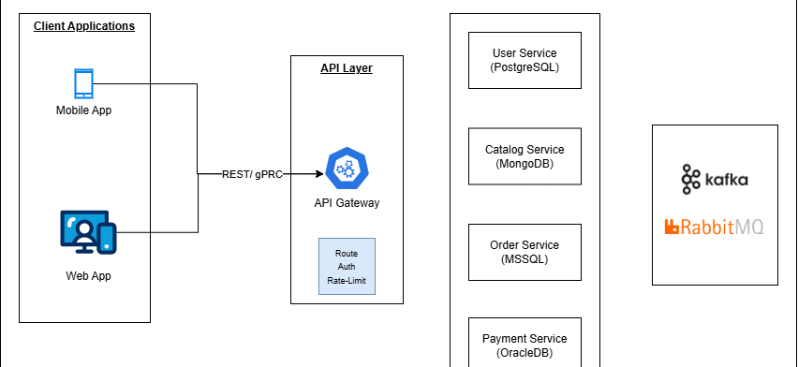
Microservices in Action: Complete Architecture

Slide 83

Database-Per-Service Pattern
Principle: Each service owns its own database, no direct database access between services
✓ Benefits
Technology choice (SQL/NoSQL
Independent scaling
Data isolation and security
⚠ Challenges
Data consistency across services
Complex queries spanning services

Slide 84
DevOps: The Cultural Shift
Microservices require DevOps mindset:
CI/CD Pipelines: Automated build, test, deploy for each service
Infrastructure as Code: Define infrastructure in code (Kubernetes YAML, Terraform)
Observability: Comprehensive logging, metrics, tracing across services
Team Autonomy: Teams own deployment and operations of their service

Slide 85
Scaling: Independent Service Growth
Key Advantage of Microservices: Scale each service independently based on actual demand
Example:
E-commerce on Black Friday
Catalog Service: Scale to 50 pods (high traffic, read-heavy)
Order Service: Scale to 30 pods (moderate traffic)
Recommendation Service: Scale to 2 pods (low traffic)
Only pay for what you use!

Slide 86
When NOT to Use Microservices
Small teams: Overhead exceeds benefits if you can't field multiple teams
Simple applications: A monolith is simpler and sufficient
No DevOps capability: Requires strong DevOps/infrastructure skills
Tight latency requirements: Network hop overhead may be critical
Limited budget: Infrastructure costs are higher

Slide 87
Module 7 - Security & Governance
Enterprise-Ready SOA & Microservices

Slide 88

Learning Objectives
Master authentication and authorization in distributed systems
Understand OAuth 2.0, JWT, and Zero Trust security models
Implement API Gateway security patterns
Design service mesh for secure inter-service communication
Meet compliance requirements (GDPR, ISO 27001)
Establish SOA governance frameworks

Slide 89

The Security Challenge
Monolithic Problem: Single point of failure, single database to compromise
SOA/Microservices Problem: Many services, many databases, many communication paths
Result: Larger attack surface, more complex to secure, but also better isolation between services

Slide 90
Core Security Principles
Defense in Depth: Multiple layers of security, not relying on a single control
Zero Trust: Never trust by default, always verify (internal services or external services)
Principle of Least Privilege: Users/services get only what they need
Encrypt Everywhere: Data in transit (Transport Layer Security - TLS) and at rest (Advanced Encryption Standard - AES)
Audit Everything: Log all access and changes for compliance

Slide 91
Authentication vs Authorization
Authentication (AuthN) - "Who are you?"
Verify identity via credentials
Username/password, MFA, OAuth
Happens once (login)
Authorization (AuthZ) - "What can you do?"
Grant/deny access to resources
RBAC, ABAC, permissions
Checked on every request

Slide 92
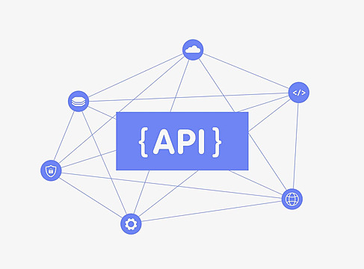
API Gateway: First Line of Defense
API Gateway is the security perimeter:
Authentication: Verify client identity before requests reach services
Rate Limiting: Prevent DDoS and brute-force attacks
Request Validation: Reject malformed or suspicious requests
Encryption (TLS): All external communication encrypted
Audit Logging: Track all API calls for compliance

Slide 93
OAuth 2.0: Industry Standard
What is OAuth 2.0?
Industry standard for secure delegated access without sharing passwords
Key Concept: Client app never sees user's password
Resource Owner: User who owns the data
Client: App requesting access (e.g., mobile app)
Authorization Server: Issues tokens after user approval
Resource Server: Your microservices protecting the data

Slide 94
OAuth 2.0: The Flow
User clicks "Login with Google" in your app
App redirects to Google Auth Server
User logs in to Google (app never sees password)
Google issues Authorization Code
App exchanges code for Access Token
App calls API with Bearer Token
Resource Server validates token and grants access

Slide 95
JWT: Token-Based Authentication
Definition: Self-contained, signed token with embedded user information
Structure: Header.Payload.Signature
✓ Stateless (no server session needed), ✓ Scalable

Slide 96
JWT: Pros & Cons
Advantages
Stateless (no session storage)
Scales horizontally
Cross-domain/CORS friendly
Mobile-friendly
Embedded claims (user data)
Disadvantages
Token revocation difficult
Token size larger than session ID
Cannot encrypt (only sign) by default
Clock skew issues
Sensitive data exposure if not encrypted

Slide 97

Service-to-Service Security
Challenge: How do services authenticate to each other securely?
Mutual TLS (mTLS): Both services present certificates, encrypt communication
Service Credentials: Each service has client ID/secret, exchanges for token
API Keys: Service A includes API key from Service B in requests
Service Mesh: Infrastructure (Istio) handles mTLS automatically

Slide 98
What is a Microservice Certificate?
What is a Microservice Certificate?
A digital (X.509) certificate used to authenticate and encrypt communication between microservices.
Commonly implemented using Mutual TLS (mTLS)
Why It Matters
🔐 Secures service-to-service traffic
✅ Verifies service identity (zero-trust)
🛡️ Prevents unauthorized access & data interception
📜 Supports compliance and audit requirements
How It Works (mTLS)
Each service has a private key + signed certificate
Both client and server verify each other
Communication is encrypted and trusted
Where Certificates Are Managed
Service Mesh: Istio, Linkerd, Consul
Kubernetes: cert-manager, Secrets
API Gateways: NGINX, Kong
Cloud / PKI: Private CA, Key Vaults
Best Practices
Use short-lived certificates
Enable automatic rotation
Avoid hardcoding secrets
Prefer service mesh–managed mTLS

Slide 99

Zero Trust: Never Trust by Default
Principle: Assume no service is trusted. Verify every request (internal or external).
Zero Trust Checklist:
Authenticate every request (even internal)
Authorize based on role/attributes
Encrypt all communication (TLS/mTLS)
Monitor all interactions for anomalies
Rotate credentials frequently
Segment network (service-to-service firewall)

Slide 100
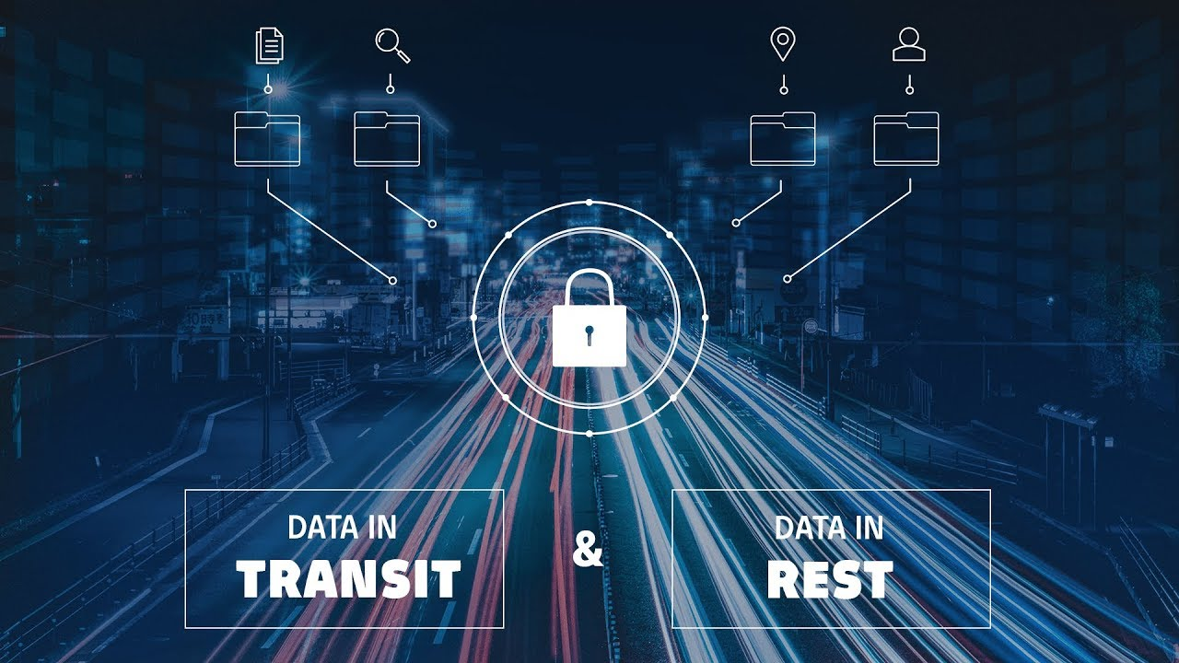
Data Security: In Transit & At Rest
In Transit
TLS 1.3 for all HTTP communication
mTLS for service-to-service
VPN for sensitive networks
At Rest
AES-256 encryption for databases
Secrets vault (HashiCorp Vault) for API keys
Field-level encryption for PII

Slide 101

Secret Management: API Keys & Credentials
NEVER commit secrets to code!
Secrets Vault: Centralized store (HashiCorp Vault, AWS Secrets Manager) with encryption
Rotate Credentials: Change API keys/passwords regularly (90 days typical)
Audit Access: Log who accessed what secrets and when
Environment Variables: Load secrets from environment, not code
Service Accounts: Each service has unique credentials

Slide 102
API Governance: Practical Standards
Naming Conventions: /api/v1/resources (snake_case), consistent patterns
Status Codes: 200=success, 400=client error, 500=server error, 429=rate limit
Error Responses: Standardized error format with error code and message
Pagination: Consistent page/limit parameters for list endpoints
Documentation: OpenAPI/Swagger specs for all endpoints
SLAs: Define uptime, latency, error rate targets per service

Slide 103
Service Registry: Governance Enabler
Service Registry: Single source of truth for all services
What to track:
Service name, version, owner team
Endpoints and API documentation
Health status and uptime SLA
Dependencies (what services does this depend on?)
Security requirements and certifications
Data classification (public, internal, sensitive)

Slide 104
Governance Models: Centralized vs Federated
Centralized
One team controls all policies
✓ Consistent, strict control
✗ Slow, bottleneck, limits agility
Federated
Teams control their services, central oversight
✓ Fast, agile, team autonomy
✗ Harder to enforce standards

Slide 105
Security Pitfalls to Avoid
Storing secrets in code or environment variables (use vault!)
No encryption for service-to-service communication
Weak or missing API authentication
No rate limiting (vulnerable to DoS)
Insufficient audit logging for compliance
Ignoring the blast radius of service compromise

Slide 106

Zero Trust: Never trust by default, always verify
OAuth 2.0 + JWT: Industry standard for API authentication
API Gateway: First line of defense, handles auth/rate limit/encryption
mTLS: Service-to-service encryption and authentication
Governance: Policies, standards, and monitoring make security consistent
Compliance by Design: Security and privacy built in from the start

